Slide 1

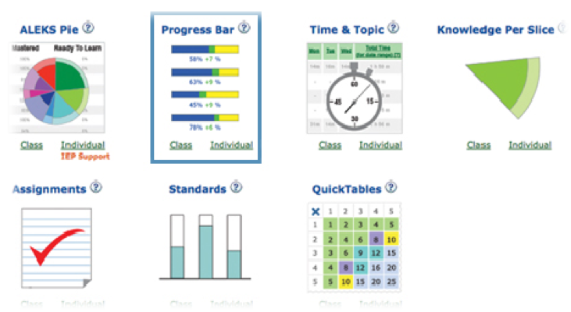
&
Performance Analysis
By:Zusammen
ABM Rocknuzzaman Muhammad Zeeshan
Abdul Rahman Khan Amin Shahin
Piush Aggarwal Tianyu Zhu

Slide 2

Student Performance and Enrollment Analysis(SEPA)
This project is aim to analyse student performance and enrolment. We have collected raw data from students based on their previous grades. The project has two parts, one is system will classify Grades into two catageories Good or Bad using Sciket learn with the help of Machine learning techniques, and in second part we visualize the pre-processed data using D3.js.

Slide 3

Project Concept Features
Analysis of student data
1.1 Subject wise performance
1.2 Sub-continent wise enrolment analysis
1.3 Department wise analysis
1.4 Analysis of source of Study

Slide 4

Description of the dataset
Source of Data:
UDE Student Data
What kind of Data:
    Student enrolment data
    Course participation data
    Students performance data
Amount of Data:
410 records of students

Slide 5
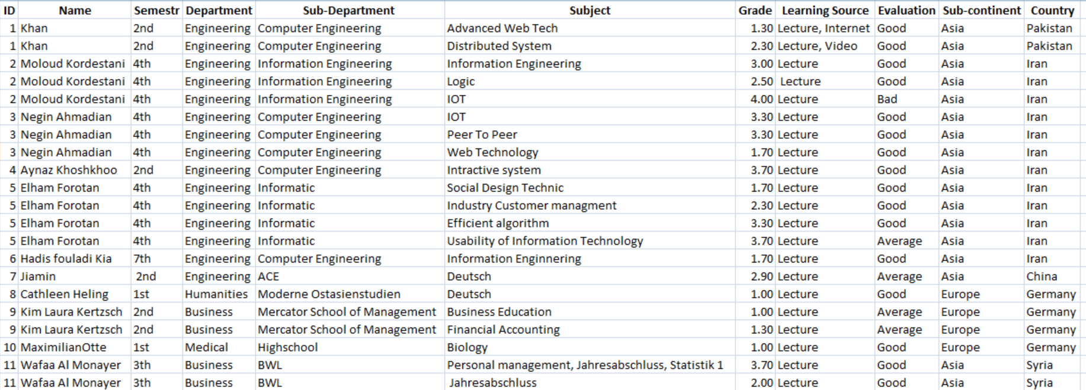
Data Set

Slide 6
What-Why-How analysis framework
What?
Why?
How?
Data Abstraction
Data type: Tables (Items and attributes)
Attributes: Categorical and Ordinal
Task abstraction
Action
Analyze: to discover patterns from the data
Target : Students
All data : Comparison
How to Encode a Vis ?
Arrange : Separate/Align
Map: Color blue
How to Interact with a Vis ?
Simple filtering

Slide 7
analysis framework
What: Data | Categorical and Ordinal
Why: Task | Compare, looks up
How: Encode | Opacity encodes focus
How: Manipulate | Select

Slide 8
Design Choice
The project aim is to check the performance of UDE students, so the best
choice is only could be bar charts-
    Choose Bar charts if categorical data
    Bar chart is suitable for comparison and Looks-up
    Easy to understand
    Finally, our aim is comparison and performance

Slide 9
Machine Learning Algorithms
Algorithm for Analysis:
Classification
Logistic Regression
KNeighbours Classifier
Random Forest Classifier
SVC(Support Vector Classifier )
Classification because of prediction of Good and Bad grades
Logistic Regression shows the prediction accuracy of 0.606 and rest of them shows 0.5

Slide 10


Implementation approach 1/2
Algorithm for Analysis:
Classification
Logistic Regression
Machine learning Tool:
Sciket learn using Python
Libraries: Pandas, numpy

Slide 11



Implementation approach 2/2
Visualization Tool:
Node.Js and Jupyter Notebook
Libraries and packages
D3.js
Matplotlib Library
NPM(Node Package Manager)

Slide 12
Project Architecture
Dataset
Analysis using Machine Learning
Prediction of Good or Bad grades
Interactive Bar charts
Bar Chart
Visualization

Slide 13
Summary
What? Data: UDE dataset Raw data generated with the help of Survey | Why? Prediction and Monitoring of Students
How? Data mining /Machine learning and Visualization | Who? Students, Teachers and Institutions
SEPA in Context of Learning Analytics

Slide 14
Work breakdown
Dataset
Analysis
&
Visualization
Tianyu Zhu
Amin Shahin
Muhammad Zeeshan
Piush Aggarwal
Abdul Rahman Khan
ABM Rocknuzzaman

Slide 15
Simple Bar Charts

Slide 16
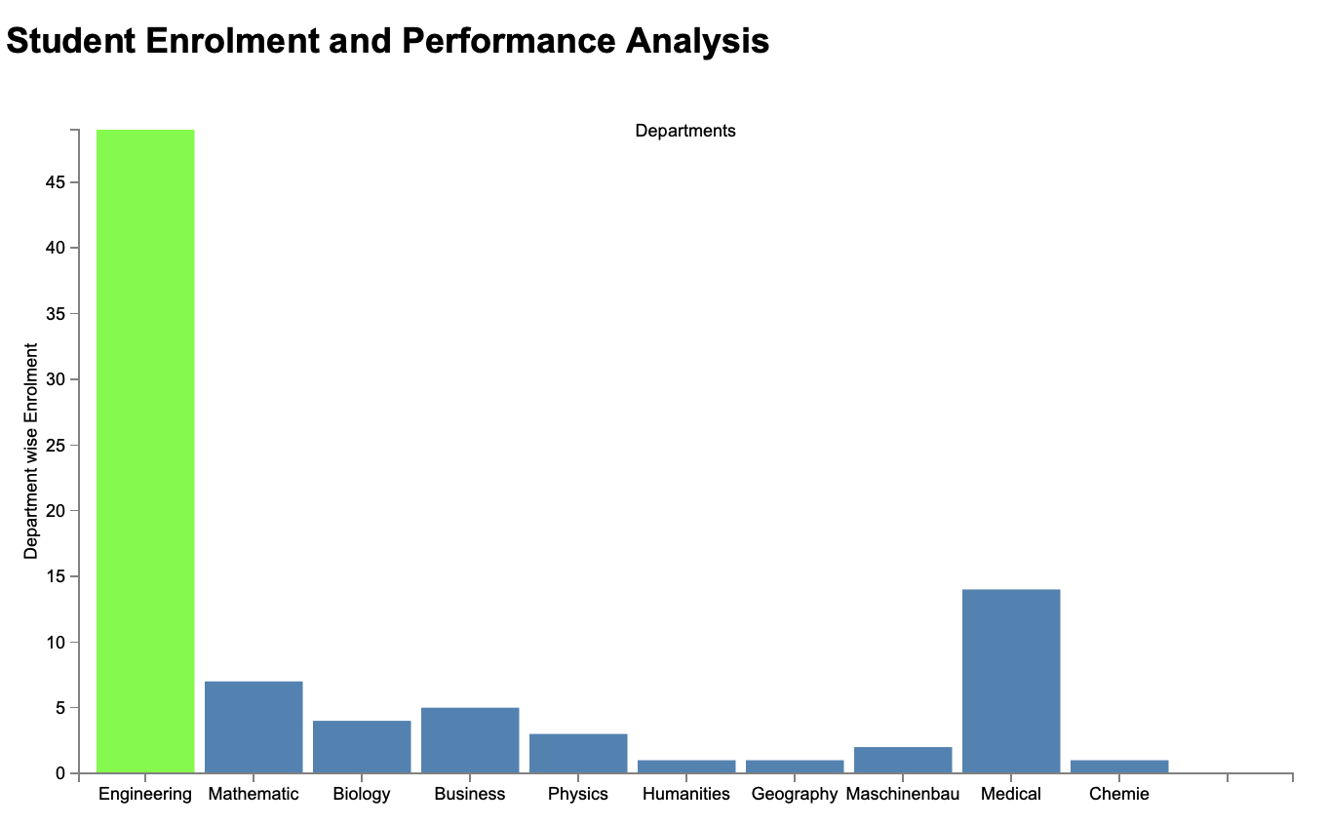
Department wise Enrollment 1/4

Slide 17
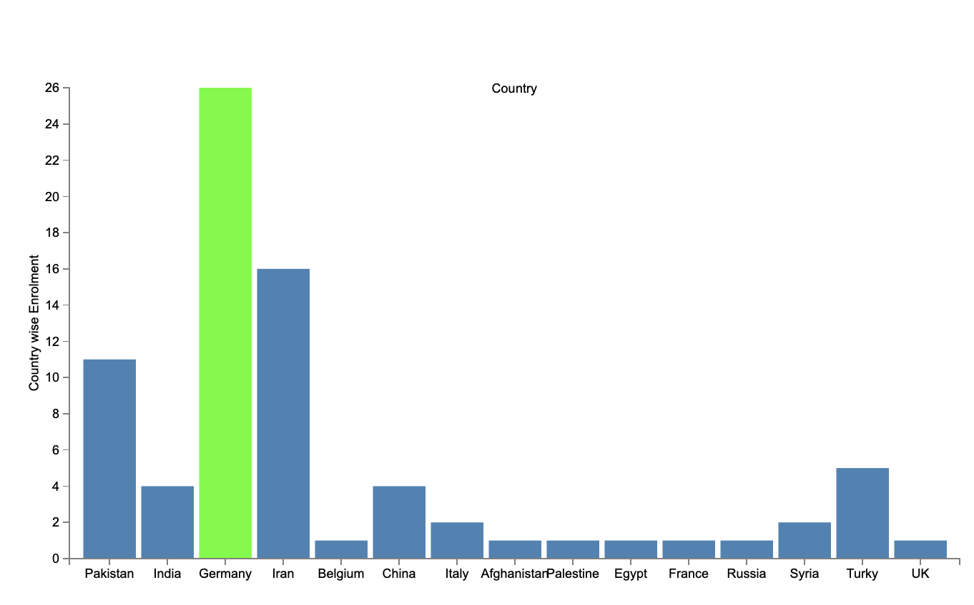
Country wise Enrollment 2/4

Slide 18
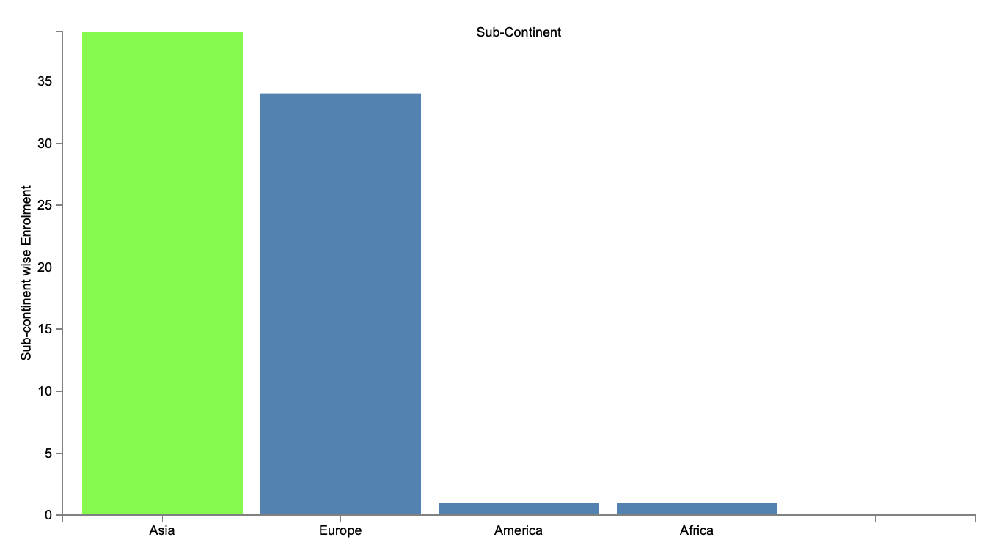
Sub-Continent wise Enrollment 3/4

Slide 19
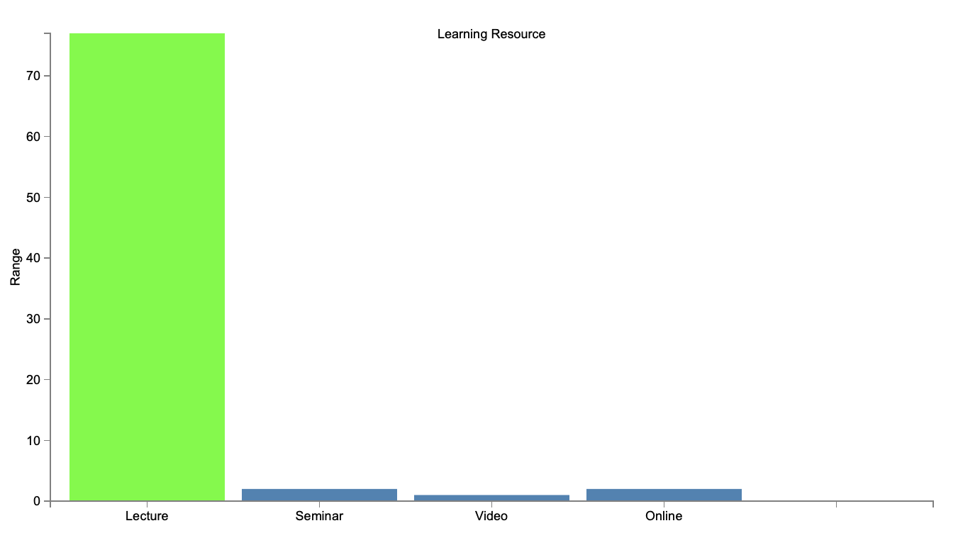
Learning Resources 4/4

Slide 20
Interactive Bar Charts

Slide 21
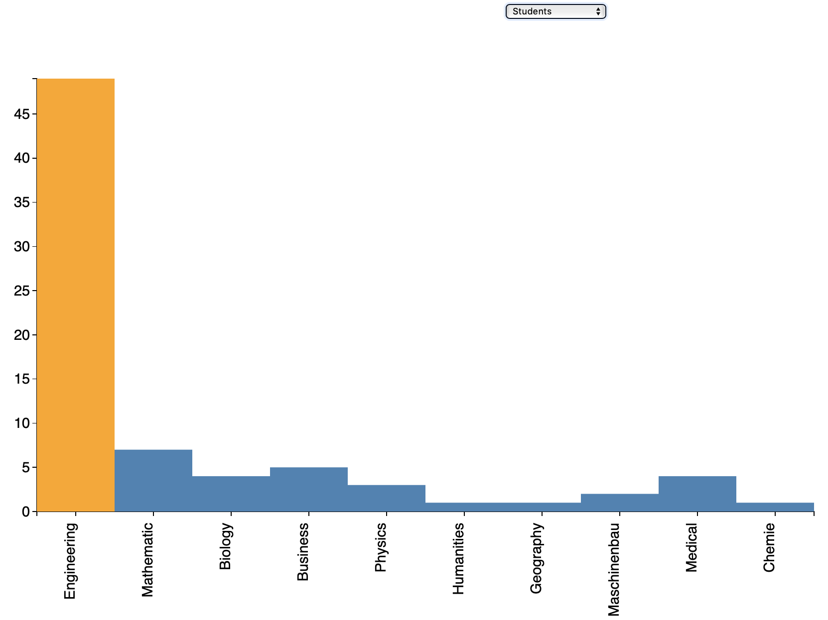
Number of Students in each Department 1/4

Slide 22
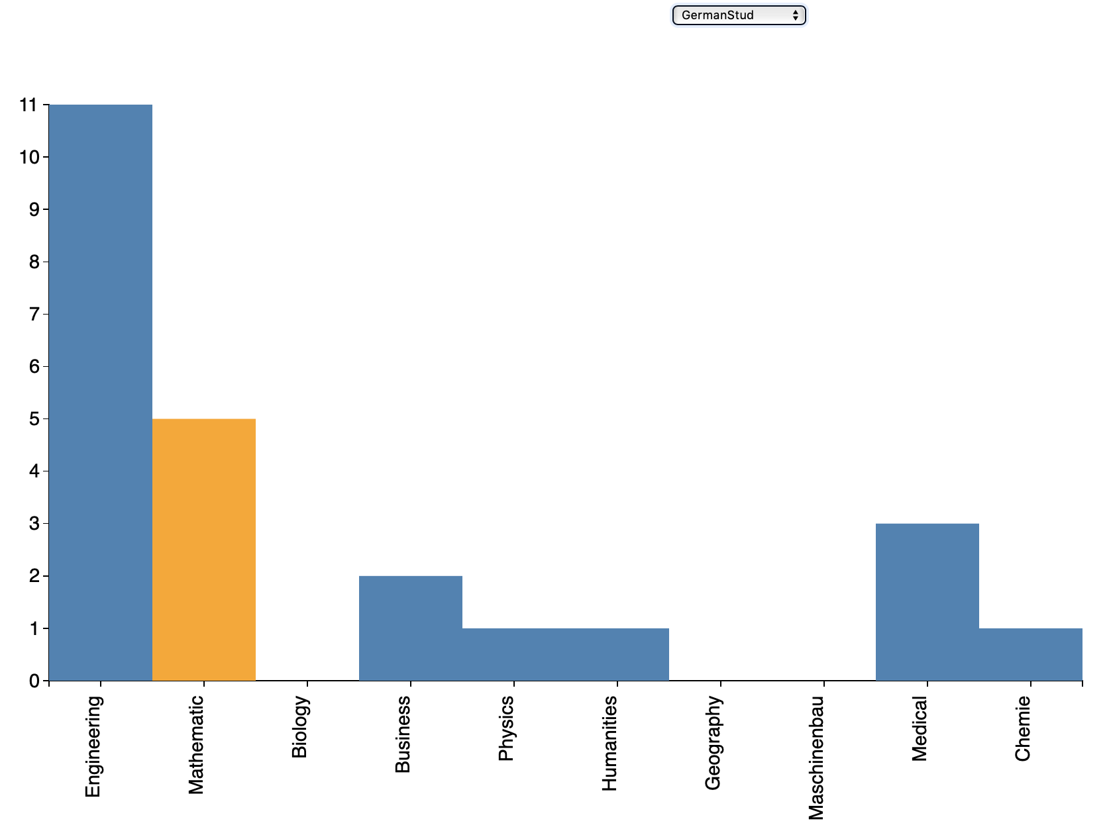
German Students in each Department 2/4

Slide 23
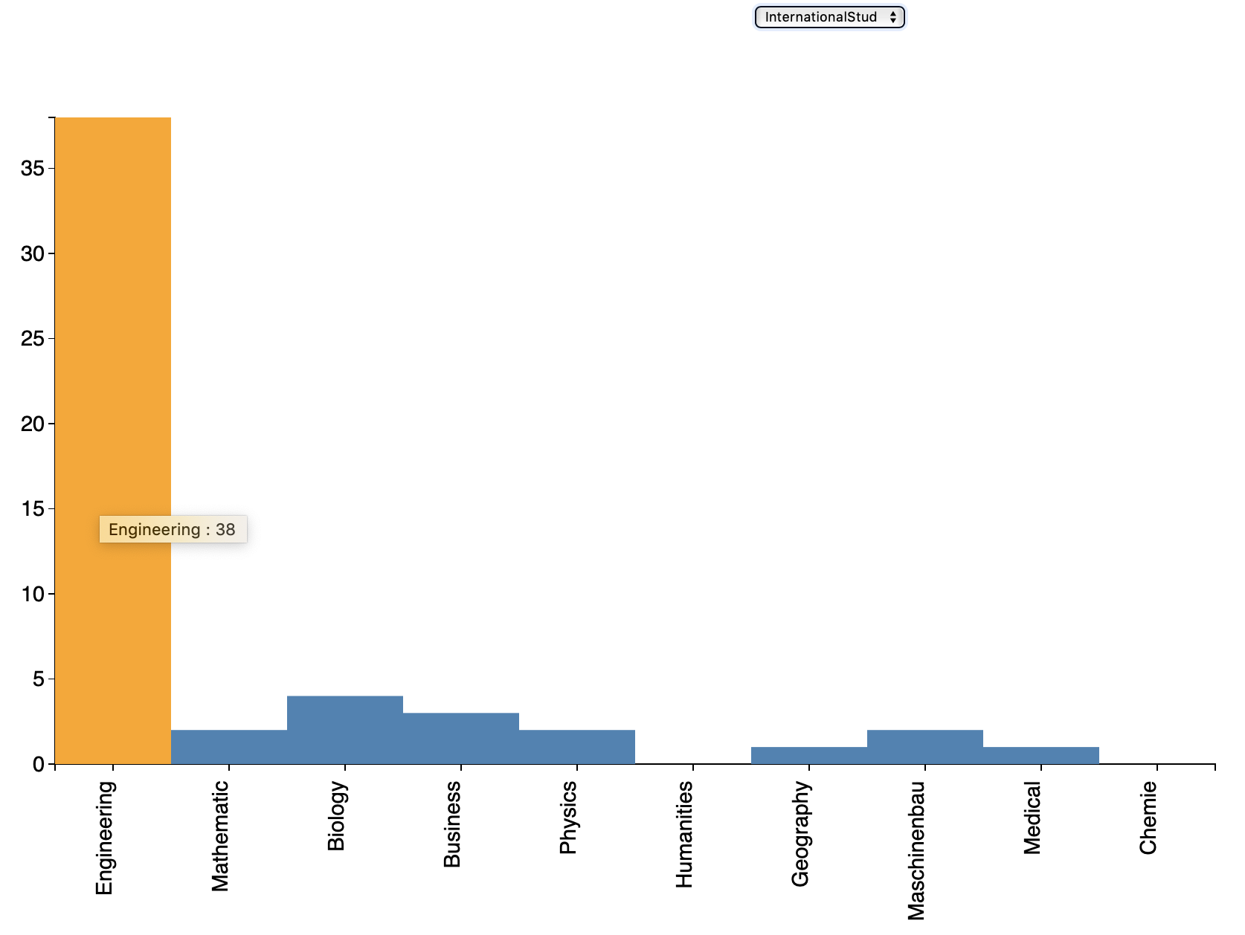
International Students in each Department 3/4

Slide 24
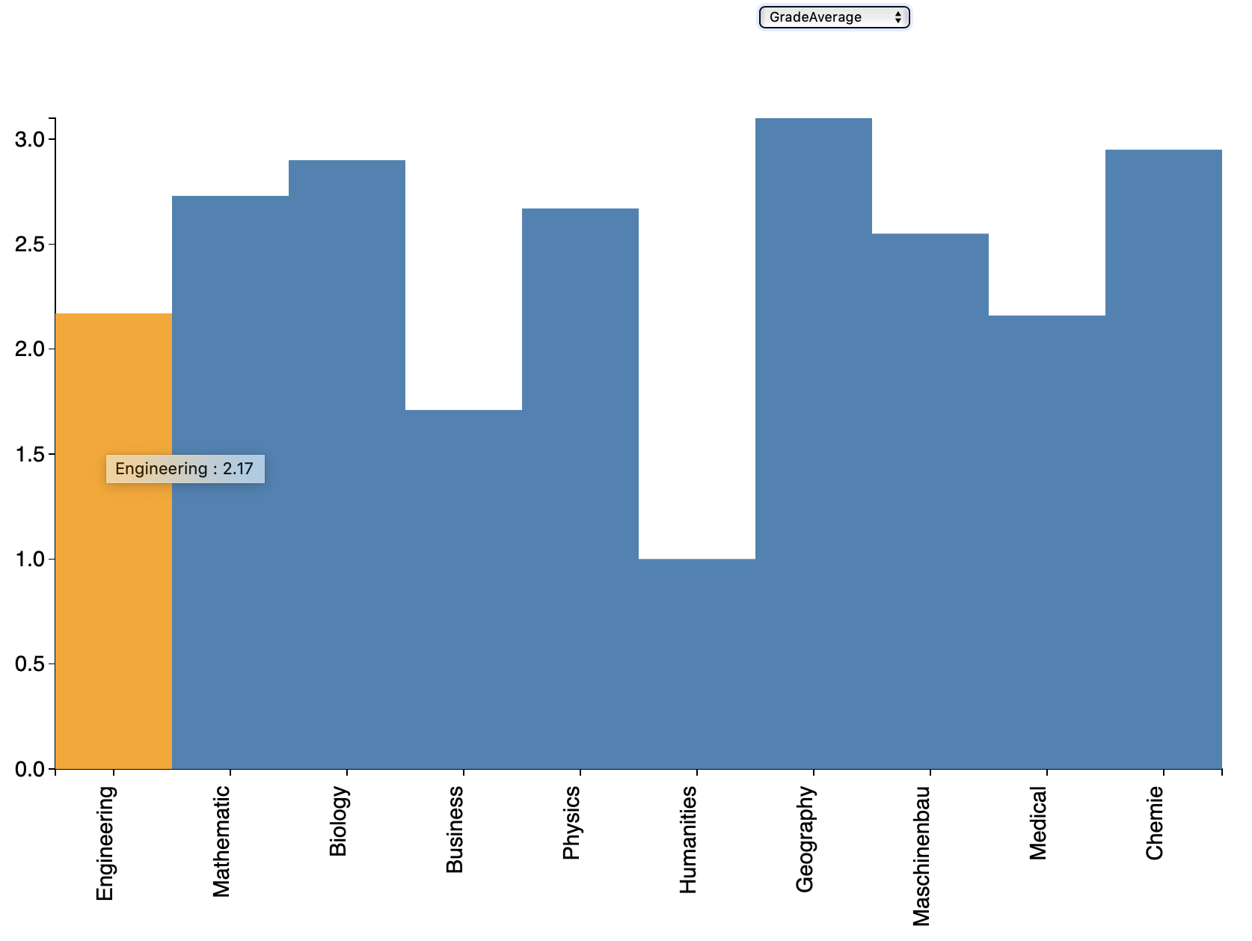
Average Grade of each Department 4/4

Slide 25
Link to the Youtube and Github
Link to Youtube
https://www.youtube.com/watch?v=vnm1HM-NzBY&feature=youtu.be
Link to the Github
https://github.com/arrahman17/Learning-Analytics-Project-

Slide 26
Thank You
Zusammen

